Slide 1
Cloud Computing
CS G527
Dr. D.V.N. Siva Kumar
CSIS Department, BITS Pilani, Hyderabad Campus

Slide 2
What is Datacenter?
Who need Datacenters?
What could be total cost of setting up a typical Datacenter (including its maintenance for a period of 5 years)?

Slide 3
What is Datacenter?
Ans: It is a building, dedicated space within a building, or a group of buildings used to house computer systems and associated components, such as telecommunications and storage systems..
In other words, the Data centers are just centralized locations where computing and networking equipment is used for the purpose of collecting, storing, processing, distributing or allowing access to mass amounts of data.

Slide 4
Things involved in setting up a Data Center and Its maintenance
Facility –Location and the usable space
Support Infrastructure:
UPS - Uninterruptible power sources
Physical security systems – the controlling of entrance and exits of the facility involves
biometrics and video surveillance systems
3. IT equipment – This is the core of the data center and contains IT operations and storage
equipment’s which includes servers, racks, cables, storage devices and to maintain a
vigilance on these crucial devices with firewalls and security devices.
4. Operation Staff
5. Licensing & Support: The cost involved in buying the OS, software etc., and the efforts involved
in getting support from the vendor when things screw up.
Reference Link : https://www.quora.com/What-is-required-to-set-up-a-data-center

Slide 5
Who need Datacenters?
Ans:
Any entity that generates or uses data has the need for data centers including government agencies, educational bodies, telecommunication companies, financial institutions, retailers of all sizes, and the social networking services such as Google and Facebook.
Some build and maintain them in-house and some rent servers at co-location facilities.
Some even use public cloud-based services too.
Note: Lack of fast and reliable access to data would mean the inability to provide vital services or loss of customer satisfaction and revenue.

Slide 6
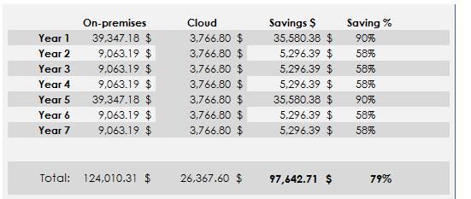
Cost Comparison of On-premises Servers versus Cloud
What could be the total cost of setting up a datacenter and its maintenance?
URL reference: https://www.sherweb.com/blog/cloud-server/total-cost-of-ownership-of-servers-iaas-vs-on-premise/

Slide 7
Computing Trends
Distributed Computing
Grid Computing
Cluster Computing
Utility Computing
Cloud Computing

Slide 8
Centralized Computing Versus Distributed Computing

Slide 9
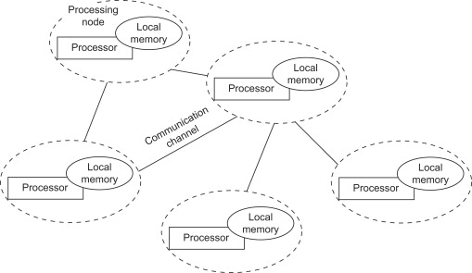
Distributed System or Computing
Def: A distributed system is a collection of independent components located on different machines that share messages with each other in order to achieve common goals.
-Distributed computing (DC) is computing over distributed autonomous computers that communicate only over a network. DC is aimed to improve efficiency and performance.
Examples of Distributed Systems are ATMs(Bank Machines), Internet, etc.
Ref: https://www.sciencedirect.com/topics/computer-science/distributed-computing

Slide 10
Why Distributed Computing?
Nature of Application
Performance
Computing Intensive: The task could consume a lot of time in
computing
Data Intensive: The task that deals with large size of datasets.
Robustness:
-No Single Point of Failure
- Other nodes can execute the same task executed on the
failed node.

Slide 11
Advantages and Disadvantages of Distributed Computing
Major benefits include:
Unlimited Horizontal Scaling - machines can be added whenever
required.
Low Latency - having machines that are geographically located closer to users, it will reduce the time it takes to serve users.
Fault Tolerance - if one server or data centre goes down, others could still serve the users of the service.
Disadvantages:
Data Integration & Consistency
Network and Communication Failure
Management Overhead

Slide 12
Computers in a Distributed Computing
Workstations: Computers used by end users to perform computing.
Servers: Computers which provide resources and
services
Personal Assistance Devices: Handheld devices connected to
the system via a wireless network.

Slide 13
Grid Computing
Def(Grid):
A grid can be defined as a large-scale geographically distributed
hardware and software infrastructure composed of heterogeneous
networked resources owned and shared by multiple administrative
organizations which are coordinated to provide transparent,
dependable, pervasive and consistent computing support to a wide range of applications.
-The grid size may vary from small to large enterprises network.
These applications can perform either distributed computing, high
throughput computing, on-demand computing, data-intensive
computing, collaborative computing or multimedia computing.
Ref: https://www.gsic.uva.es/uploaded_files/BoteACG03.pdf

Slide 14
Grid Computing (Cont…)
Grid computing is a group of computers physically connected (over a network or with Internet) to perform a dedicated tasks together, such as analyzing e-commerce data and solve a complex problem
All machines on that network work under the same protocol to act like a virtual supercomputer. The task that they work on may include analyzing huge datasets or simulating situations which require high computing power.
Computers on the network contribute resources like processing power and storage capacity to the network.
Note: Grid Computing is a subset of distributed computing, where a virtual super computer comprises of machines on a network connected by some bus, mostly Ethernet or sometimes the Internet.

Slide 15
Grid Computing (Cont…)
Users (or client applications) gain access to computing resources (processors, storage, data, applications and so on) as needed without any information about the location of these resources and the underlying hardware and operating systems.
The Grid links together computing resources (PCs, Workstations, Servers, Storage elements and provides a mechanism to access these.

Slide 16
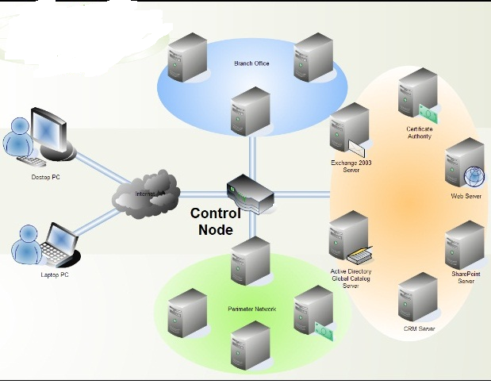

Slide 17
Need of Grid Computing
The basic idea of Grid Computing is to utilize the idle CPU cycles and storage of million of computer systems across a worldwide network function as a flexible, pervasive, and inexpensive accessible pool that could be harnessed by anyone who needs it, similar to the way power companies and their users share the electrical grid.
Exploiting underutilized resources.
Today’s Scienece/Research is based on computations, data analysis, data visualization and collaborations where grid computing could be helpful.
Scientific and Engineering problems are becoming more complex and users prefer more accurate, precise solutions to their problems in the shortest possible time.
Example applications of Grid computing are in various domains: Weather forecast applications, Protein Analysis, Detection and modelling natural disasters, etc.

Slide 18
Types of Grids
Computational Grid: It provide secure access to huge pool of shared processing power suitable for high throughput applications and computation intensive computing.
Data Grid: It provides an infrastructure to support data storage, data discovery, data handling, data publication, data manipulation of large volumes of data actually stored in various heterogeneous databases and file systems.
Collaborative Grid: It is the grid which solves collaborative problems.

Slide 19
Advantages and Disadvantages of Grid Computing
Advantages:
It can solve more complex problems in a very short span of time.
It can easily combine with other organizations.
It can make better use of existing hardware.
Scalability
Disadvantages:
Challenges with sharing resources (especially across different admin domains)
It is very non interactive.

Slide 20
Cluster Computing
Clustering refers to establishing connectivity among two or more servers in order to make it work like one.
Cluster computing or High-Performance computing frameworks is a form of computing in which bunch of computers (often called nodes) that are connected through a LAN (local area network) so that, they behave like a single machine.
A computer cluster is a single logical unit consisting of multiple computers that are linked through a LAN. The networked computers essentially act as a single, much more powerful machine.
A computer cluster provides much faster processing speed, larger storage capacity, better data integrity, superior reliability and wider availability of resources.
The connected computers execute operations all together thus creating the impression like a single system (virtual machine).
Ref: https://www.watelectronics.com/cluster-computing-architecture-its-types/

Slide 21
Need for Cluster Computing
It resolves the need for content criticality and process services quickly.
It also offers solutions to solve complicated problems by providing faster computational speed, and enhanced data integrity.
Example applications include:
Film industry: They require it for rendering extended quality of graphics and cartoons.
Internet Service Providers look for enhanced availability in a scalable approach, cluster computing will provide this.
Many of the organizations and IT giants are implementing this technology to augment their scalability, processing speed, availability and resource management at the economic prices.

Slide 22
Cluster Computing (…)
Cluster computing goes with the features of:
All the connected computers are the same kind of machines.
They are tightly connected through dedicated network connections
All the computers share a common home directory.
Many organizations and IT giants are implementing cluster computing to augment their scalability, processing speed, availability and resource management at the economic prices.

Slide 23
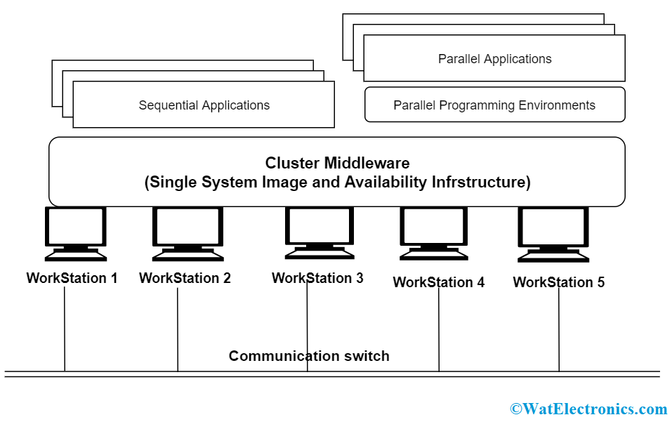

Slide 24
Advantages and Disadvantages of Cluster Computing
Advantages:
Processing speed
Extended resource availability
Expandability
Flexibility
Disadvantages:
High Cost (due to the requirement of good hardware and a design)
Maintenance because more systems are involved.

Slide 25
Utility Computing
It is a service provisioning model in which a service provider makes computing resources and infrastructure management available to the customer as needed, and charges them for specific usage rather than a flat rate.
Consumers pay providers based on usage (“pay-as-you-go”), similar to the way in which we currently obtain services from traditional public utility services such as water, electricity, gas, and telephony.
It minimizes the associated costs and maximizes the efficient use of resources.
The advantage of utility computing is that it reduced the IT cost, provides greater flexibility, and easier to manage.

Slide 26
Cloud Computing
Cloud Computing is a general term used to describe a new class of network based computing that takes place over the Internet,
basically a step on from Utility Computing
a collection/group of integrated and networked hardware, software and Internet infrastructure (called a platform).
Using the Internet for communication and transport provides hardware, software and networking services to clients
These platforms hide the complexity and details of the underlying infrastructure from users and applications by providing very simple graphical interface or API (Applications Programming Interface).

Slide 27
Cloud Computing (cont.…)
In addition, the platform provides on demand services, that are always on, anywhere, anytime and any place.
Pay for use and as needed, elastic
scale up and down in capacity and functionalities
The hardware and software services are available to
general public, enterprises, corporations and businesses markets
Note: Cloud computing can be referred to as a method for delivering information technology (IT) services to the users through web-based tools and applications with the help of the internet.

Slide 28
Cloud Computing: Definition
The US National Institute of Standards (NIST) defines cloud computing as follows:
Cloud computing is a model for enabling ubiquitous, convenient, on-demand network access to a shared pool of configurable computing resources (e.g., networks, servers, storage, applications, and services) that can be rapidly provisioned and released with minimal management effort or service provider interaction.
Notes:
RL 1.2

Slide 29
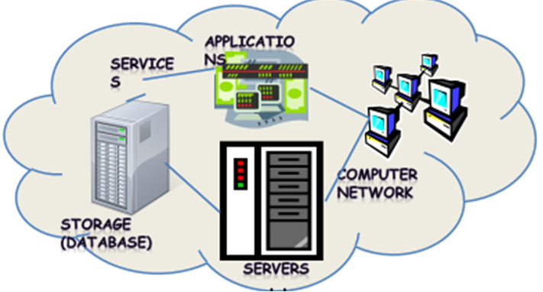
Cloud Computing
Shared pool of configurable computing resources
On-demand network access
Provisioned by the Service Provider

Slide 30
DESIRED FEATURES OF A CLOUD
1. Self-Service: Cloud must allow self-service access so that customers can request, customize, pay, and use services without intervention of human operators.
2. Per-Usage Metering and Billing: Services must be priced on a short-term basis (e.g., by the hour), allowing users to release (and not pay for) resources as soon as they are not needed. Cloud must implement features to allow efficient trading of service such as pricing, accounting, and billing. Metering should be done accordingly for different types of service (e.g., storage, processing, and bandwidth) and usage promptly reported, thus providing greater transparency.

Slide 31
DESIRED FEATURES OF A CLOUD (Cont…)
3. Elasticity: To rapidly provide resources in any quantity at any time. Additional resources need to be (scale up and down) :
(a) provisioned, possibly automatically, when an application load increases (Scale Up).
(b)released when load decreases (Scale Down).
4. Customization: In a cloud scenario, great disparity between user needs is very common. Therefore, resources rented from the cloud must be highly customizable as per the users’ requirements.

Slide 32
3-4-5 rule of Cloud Computing
NIST specifies 3-4-5 rule of Cloud Computing
3 cloud service models that consists of the particular types of services that you can access on a cloud computing platform.
4 deployment models, which refer to the location and management of the cloud’s infrastructure.
5 essential characteristics of cloud computing infrastructure

Slide 33
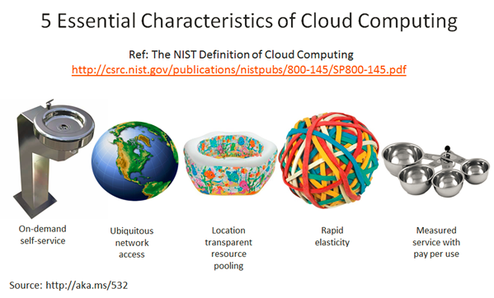
Characteristics of Cloud Computing
On demand self-service
Broad network access
Resource pooling
Rapid elasticity
Measured service

Slide 34
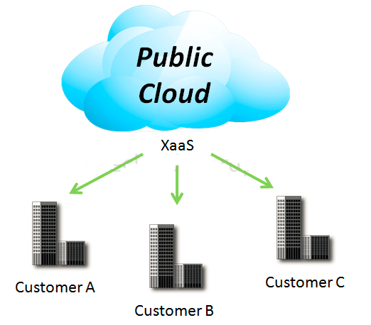
4 Deployment Models
1. Public Cloud
Mega-scale cloud infrastructure is made available to the general public or a large industry group and is owned by an organization selling cloud services.
The physical and IT infrastructure and applications exist at the providers location
Notes:
XaaS is Anything as a service
[http://www.definethecloud.net/cloud-types/]

Slide 35
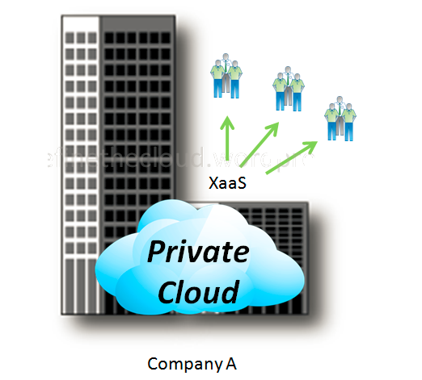
4 Deployment Models
2. Private Cloud
The cloud infrastructure is operated solely for an organization. It may be managed by the organization or a third party and may exist on premise or off premise.
- The users of private cloud are the internal business units or divisions.

Slide 36
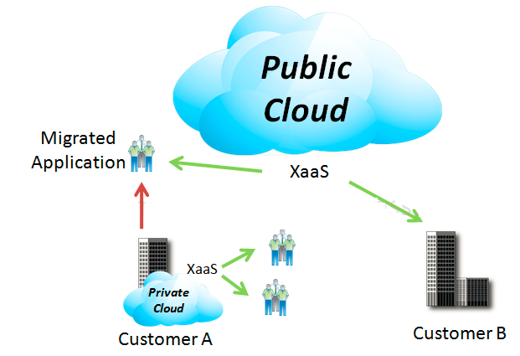
4 Deployment Models
3. Hybrid Cloud
The cloud infrastructure is a composition of two or more clouds (private, community, or public).
Each cloud retain its features but can share data if required.

Slide 37
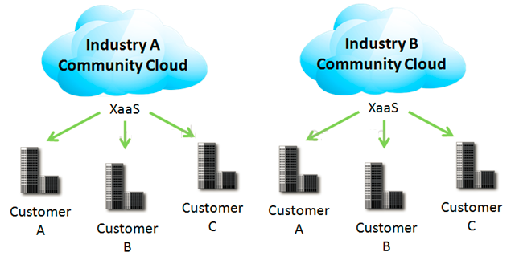
4 Deployment Models
4. Community Cloud
Community Cloud is an infrastructure shared by a specific community of users or organizations to serve a common function or purpose. It may be for one organization or for several organizations, but they share common concerns
such as their mission, policies, security, regulatory compliance needs, and so on. It may be managed by the organizations or a third party and may exist on premise or off premise’ according to NIST.
E.g. OpenCirrus

Slide 38
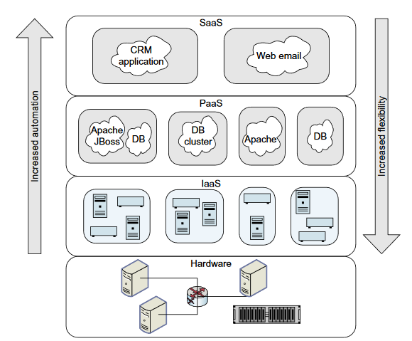
3 Cloud Service Models
Notes:
RL 1.3

Slide 39
Software as a Service (SaaS)
In the SaaS model, the application is provided to the users through a thin client interface (a browser, usually), and the customer’s responsibility begins and ends with entering and managing its data and user interaction.
Here, the users don’t need to download software and install on their systems. The users do not control the hardware network, security, OS.
A single instance of the software runs on the cloud and services multiple end users or client organizations.
Examples of SaaS are:
salesforce.com , Google docs, Microsoft Office 365, etc.

Slide 40
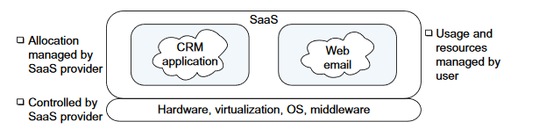
Software as a Service (SaaS)

Slide 41
Platform as a Service (PaaS)
It is a service that can be used to build higher-level services (Applications). The user is provided the hardware infrastructure, network, and OS to form a hosting environment. This would be used mostly by developers.
2 Perspectives for PaaS :-
1. Producer:- Someone producing PaaS might produce a platform by integrating an OS, middleware, application software, and even a development environment that is then provided to a customer as a service.
2. Consumer:-Someone using PaaS would see an encapsulated service that is presented to them through an API. The customer interacts with the platform through the API, and the platform does what is necessary to manage and scale itself to provide a given level of service. Virtual appliances can be classified as instances of PaaS.
Examples of PaaS are:
AWS Elastic Beanstalk, Google App Engine, and Windows Azure, etc.

Slide 42
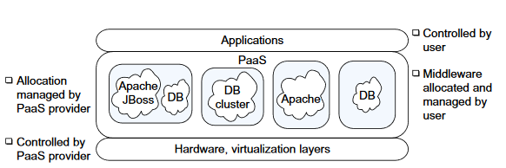
Platform as a Service (PaaS)

Slide 43
Infrastructure as a Service (IaaS)
Infrastructure as a service delivers basic storage and computing capabilities as standardized services over the network.
The user gets resources (infrastructure) such as processing power (CPUs), storage, network bandwidth, etc.
Once the user acquires the infrastructure, he/she controls the OS, data, applications, services, host-based security, etc.
Examples of IaaS are:
Amazon EC2, Google Cloud Platform, Eucalyptus, Rackspace.

Slide 44
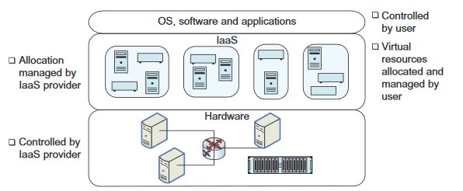
Infrastructure as a Service (IaaS)

Slide 45
Cloud Service Provider (CSP)’s Characteristics
Provide on-demand provisioning of computational resources
Use virtualization technologies to lease these resources
Provide public and simple remote interfaces to manage those resources
Use a pay-as-you-go cost model, typically charging by the hour
Operate data centers large enough to provide a seemingly unlimited amount of resources to their clients

Slide 46
The use of “Cloud” Makes refers to:
The “cloud” makes reference to the following two essential concepts:
Abstraction: Cloud computing abstracts the details of system implementation from users and developers. Applications run on physical systems that aren’t specified, data is stored in locations that are unknown, administration of systems is outsourced to others, and access by users is ubiquitous.
2. Virtualization: Cloud computing virtualizes systems by pooling and sharing resources. Systems and storage can be provisioned as needed from a centralized infrastructure, costs are assessed on a metered basis, multi-tenancy is enabled, and resources are scalable with agility.

